Slide 1

网站首页
Group 13
The website about local peace agreements

Slide 2


Background
Introduction on local peace agreement
A publicly available written agreement between locally-based actors which addresses local conflict-generating grievances within a part of the wider conflict-affected area
Our dataset
This database lists all agreements included on the main PA-X database that deal in some way with local issues, in cases of local negotiation practices that are on the margins of wider conflict, or in cases of local/communal violent conflict. The detailed database covers 25 countries in the Asia-Pacific region, Middle East and North Africa, Europe and Eurasia, Africa（excl MENA） and Cross-regional five regions, with a total of about 286 agreements between 1990 and 2020.The dataset are settled into three parts, basic information, local agreement properties, and local agreement issues.

Slide 3


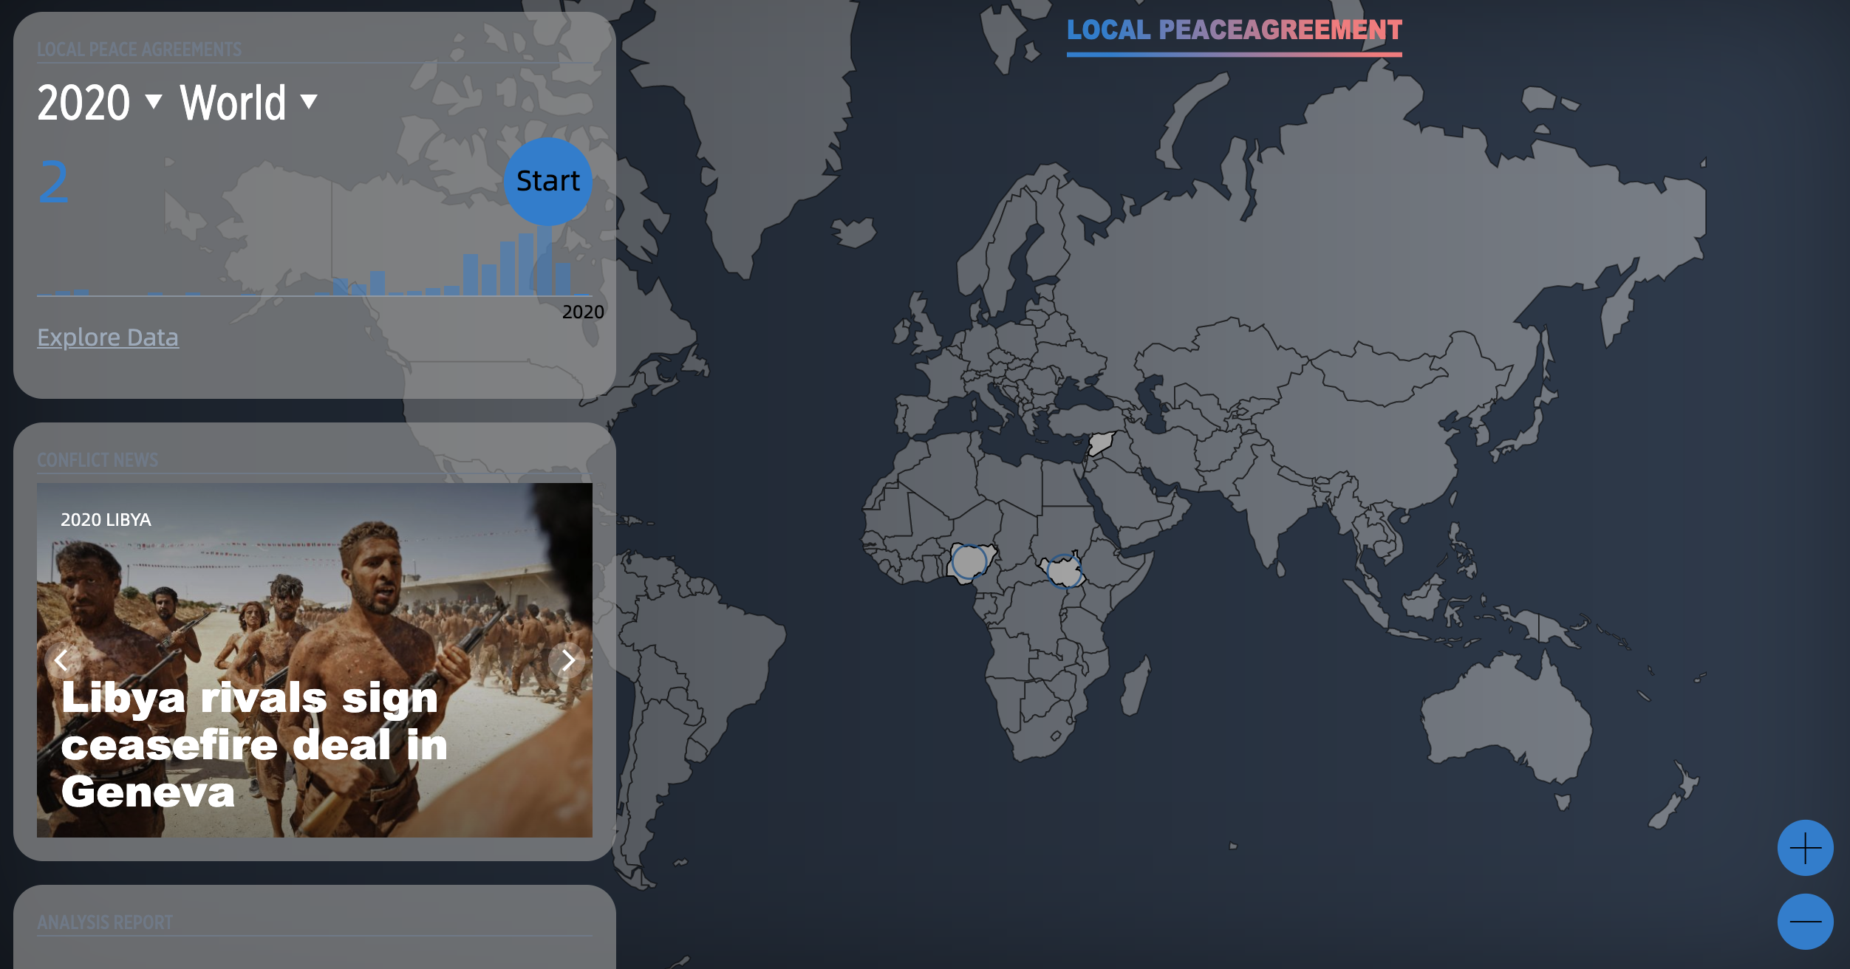




Introduction
Goal
The signing of the local peace agreement will promote peace between the regions.We‘d like to let people know more about the role of local peace agreements playing in the peace progress.
The target audiences
Socialists/researchers
Potential mediators
Peace-loving people
Output
An interactive website about local peace agreements
Report on local peace agreements

Slide 4
Basic information
Introduction
In assignment 2, our group carried out some basic analyses of the data, such date signed, agreement definition and status, agreement stage, location of these countries, local agreement properties, mediator.etc
Conclusion
We found some interesting results.
Local peace agreements mainly signed by Africa and Middle East countries
Number of local peace agreements surged after 2013, and peaked at 2018
（PT）Evidence of a clear culture or practice of local peace agreement mainly located in Middle East and North Africa
Different regions tend to have different mediators
Questions
Does the number of local peace agreement affect the number of wars?
How does mediator affect peace agreements and local peace?
What factors might affect the type of mediator?

Slide 5
Research
Does the number of local peace agreement affect the number of wars?
Necessary but not sufficient conditions for sustainable peace
“ Negotiated civil war terminations differ from their interstate war counterparts in that one side must disarm and cease to exist as a fighting entity. While termination through military victory provides a relatively more enduring peace, many civil wars end with peace agreements signed after negotiations. However, research has shown that the implementation of civil war peace agreements is difficult and prone to collapse. Often these failures are followed by recurrence of the conflict. In some cases, the agreements break down before key provisions are implemented. This article adds to this topic by focusing on the role of state capacity in peace agreement success. We argue that peace agreements and state capacity are necessary but not sufficient conditions for sustainable peace.”
DeRouen Jr, K., Ferguson, M. J., Norton, S., Park, Y. H., Lea, J., & Streat-Bartlett, A. (2010). Civil war peace agreement implementation and state capacity. Journal of Peace Research, 47(3), 333-346.
Hypothesis
Increase in the number of local peace agreements means more conflicts
Increase in the number of local peace agreements means stronger peace consciousness and prediction of peace
Number of local peace agreements have no relate directly to conflicts

Slide 6
Research
How does mediator affect peace agreements and local peace?
Positive effects
“ championed the positive effects of mediation by regional organizations on conflict resolution”
Gartner, S. S. (2011). Signs of trouble: Regional organization mediation and civil war agreement durability. The Journal of Politics, 73(2), 380-390.
Roles
“ It was found that a mediator intervenes because of its interest in the conflict or in obtaining an outcome, and it can play three roles-communicator, formulator, manipulator- in accomplishing its objectives.”
Zartman, I. W. , & Touval, S. . (1985). International mediation: conflict resolution and power politics. Journal of Social Issues.
Sustain peace
“ We find that peace agreements are more likely to sustain peace after civil wars if they involve third party mediators in the stages of agreement design and implementation to reduce uncertainties resulting from the commitment problem, especially when the state capacity is weak.”
Negotiated settlement and the durability of peace: Agreement design, implementation, and mediated civil wars, Chong Chen

Slide 7
Research
What factors might affect the type of mediator?
The capacity of the insurgents
“ The results suggest that relatively stronger insurgents are more likely to force the state to open a mediation process and eventually concede some form of settlement.”
Clayton, G. (2013). Relative rebel strength and the onset and outcome of civil war mediation. Journal of Peace Research, 50(5), 609-622.
Cultures
“ Support for the hypothesis that mediation is more likely to succeed when the parties are from similar social cultures. We also find that mediation is more likely to succeed when the parties share democratic political cultures, a finding that is consistent with the cultural/normative explanation for the democratic peace. ”
Leng, R. J., & Regan, P. M. (2003). Social and political cultural effects on the outcomes of mediation in militarized interstate disputes. International Studies Quarterly, 47(3), 431-452.
Economic
“ Even though the relevance of business actors in peace processes is increasingly acknowledged, analysis of their particular roles and contributions remain sparse in peace mediation literature.”
Iff, A., & Alluri, R. M. (2016). Business actors in peace mediation processes. Business and Society Review, 121(2), 187-215.

Slide 8
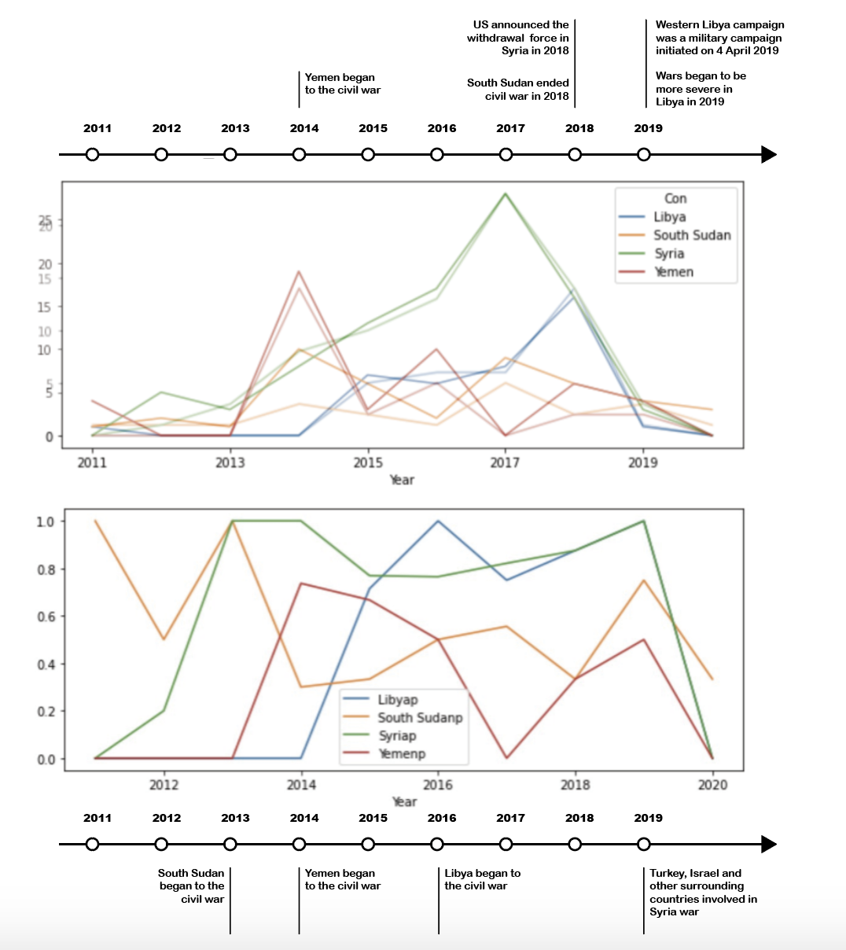
Anaysis 1
Does the number of local peace agreement affect the number of wars?
With hypotheses, we made a timeline with important timepoint of the four countries which have the most local peace agreements.
For these four countries, the rises and peaks in the number of local peace agreements have different conclusions. For two of them the peaks mean the peace is coming soon, but for others, the peaks means conflicts are getting worse. These are two opposite conclusions, so we introduce the pax_all_agreements data and find the trend are the same. So we still couldn’t draw conclusion on the relationship between the number of local peace agreements and the war processes, because maybe it isn’t local peace agreements influence conflicts, but other peace agreements do.
So we made a graph on the percentage of local peace agreements and we could see peaks of percentage of local peace agreements usually mean the beginning of wars or a new stage of wars. We guess it is because at the beginning of a war, many citizens are pursuing peace,but there are not much consensus that the two sides could achieve. So they have to sign local peace agreements to seek for local peace.

Slide 9
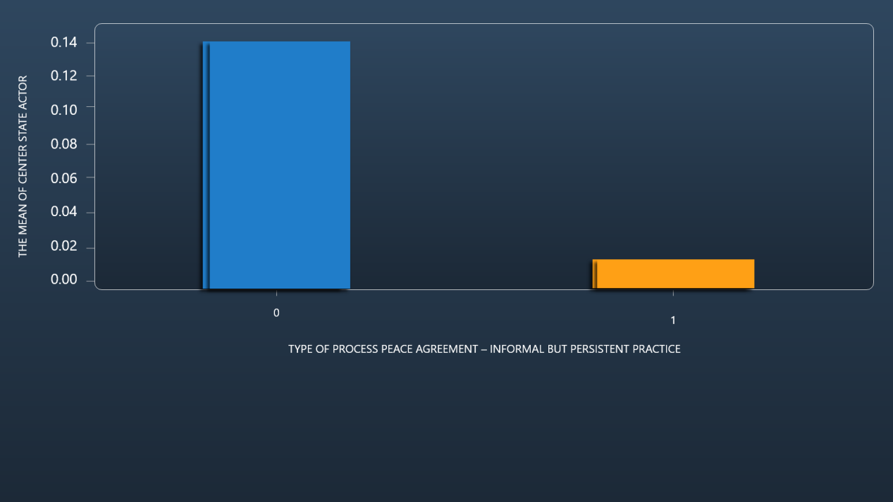
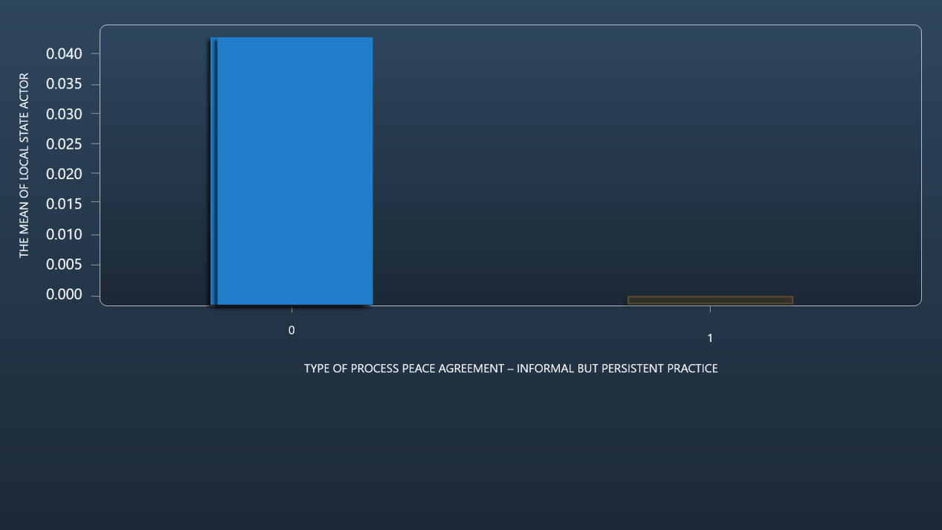
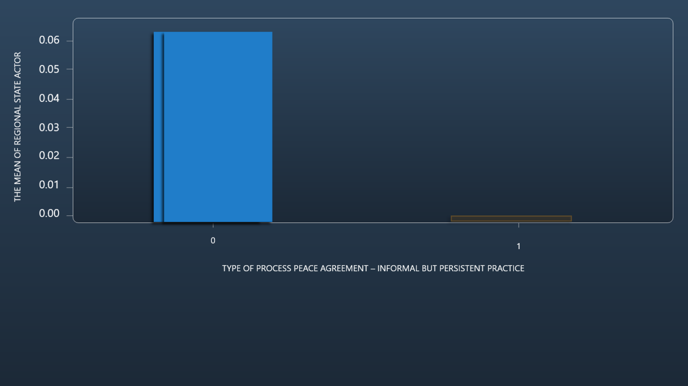
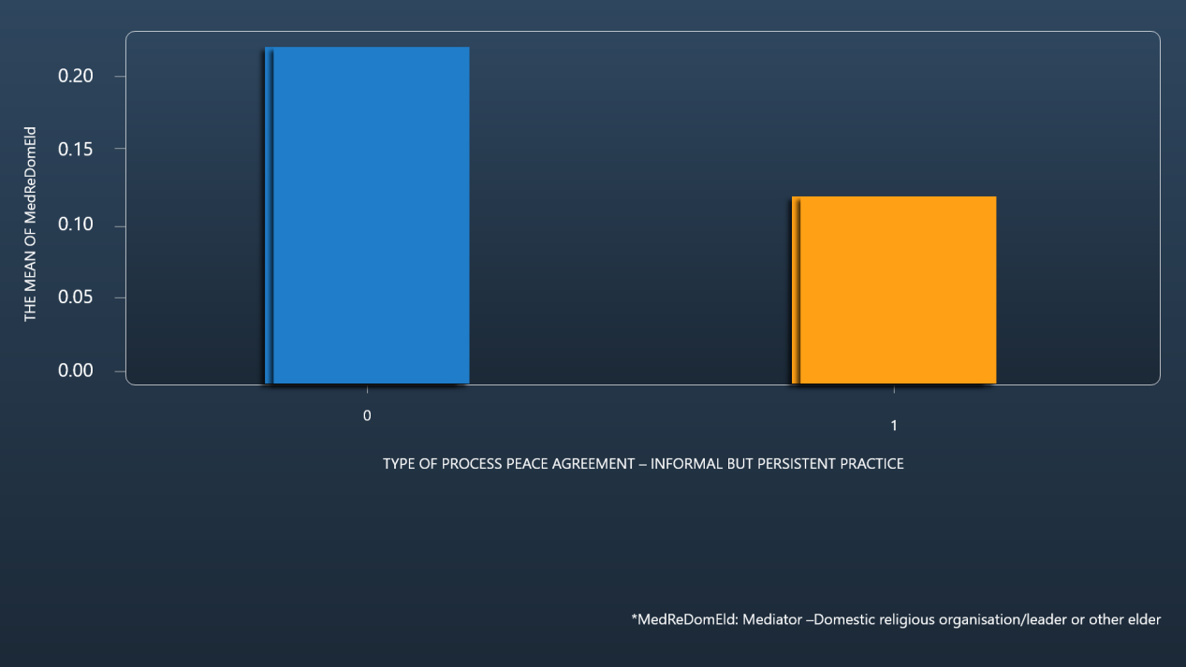
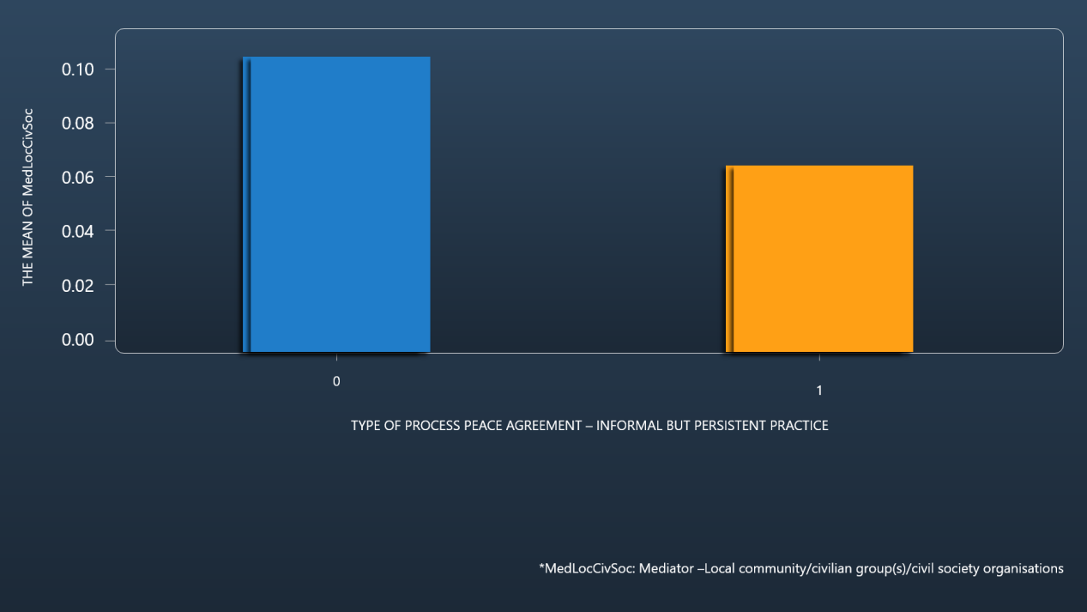

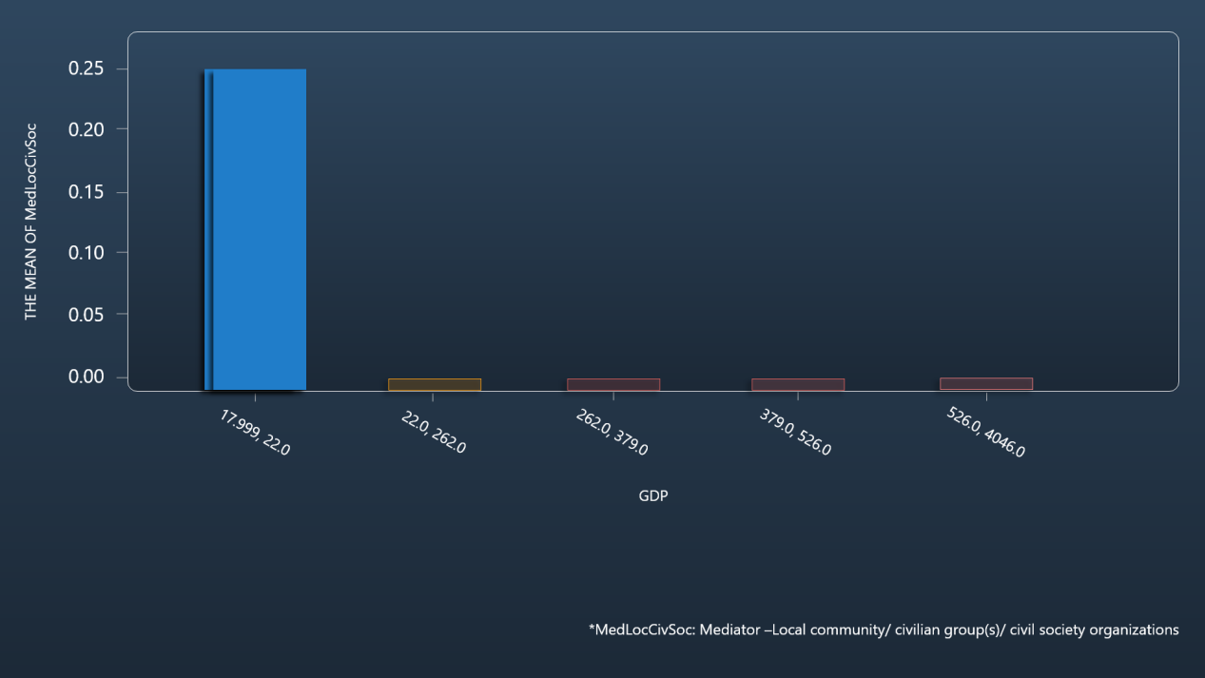
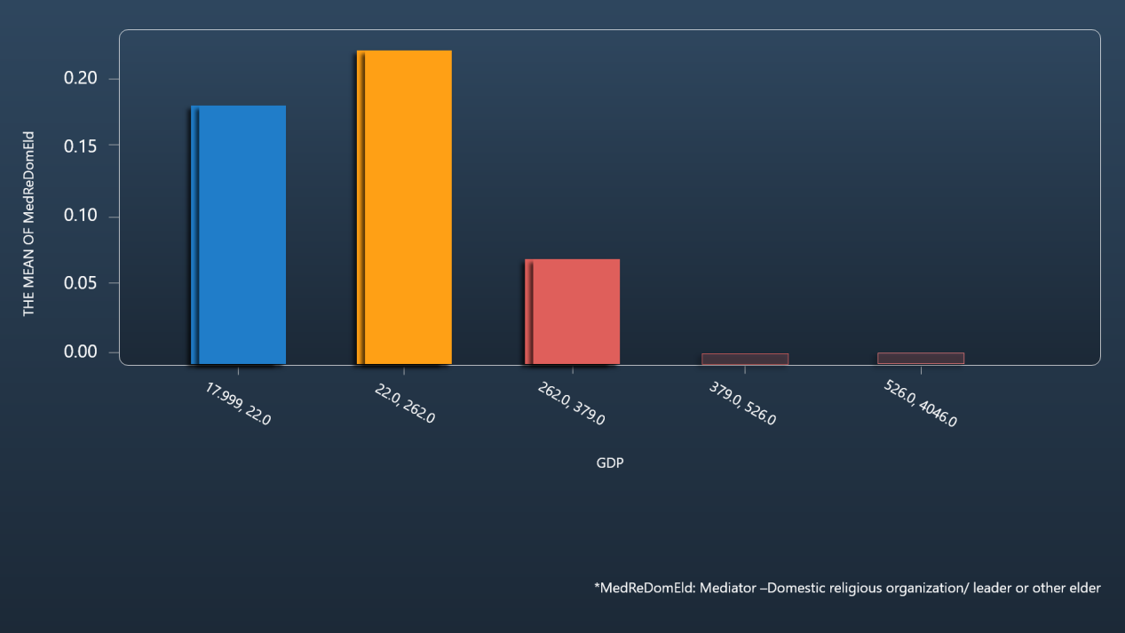
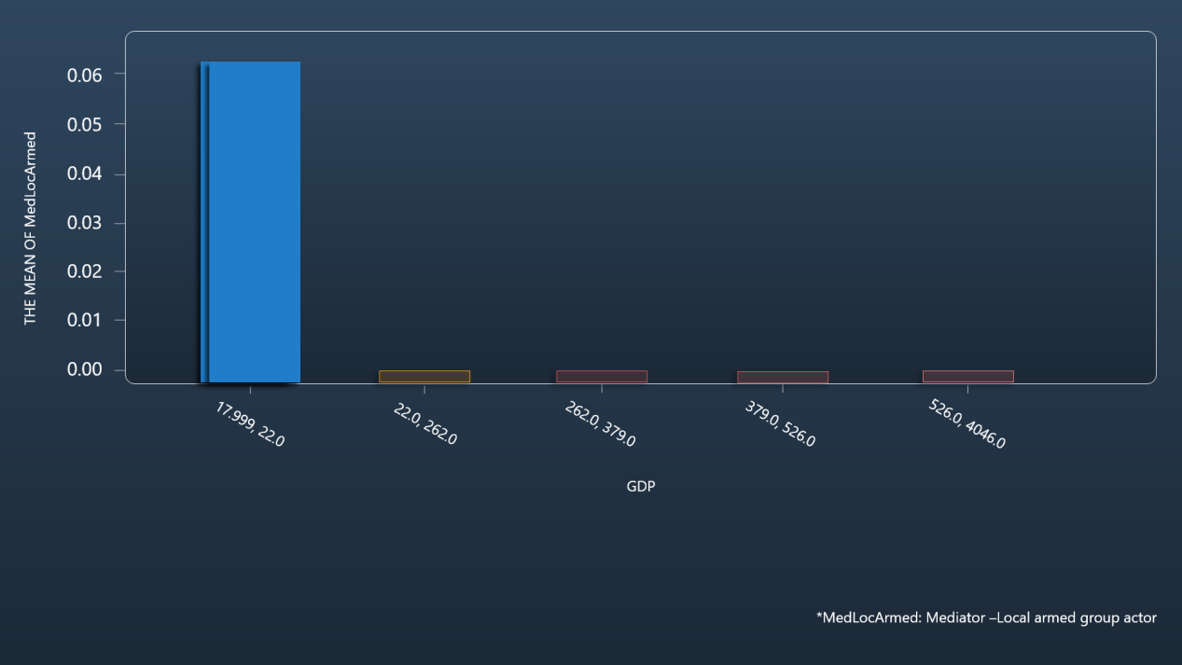
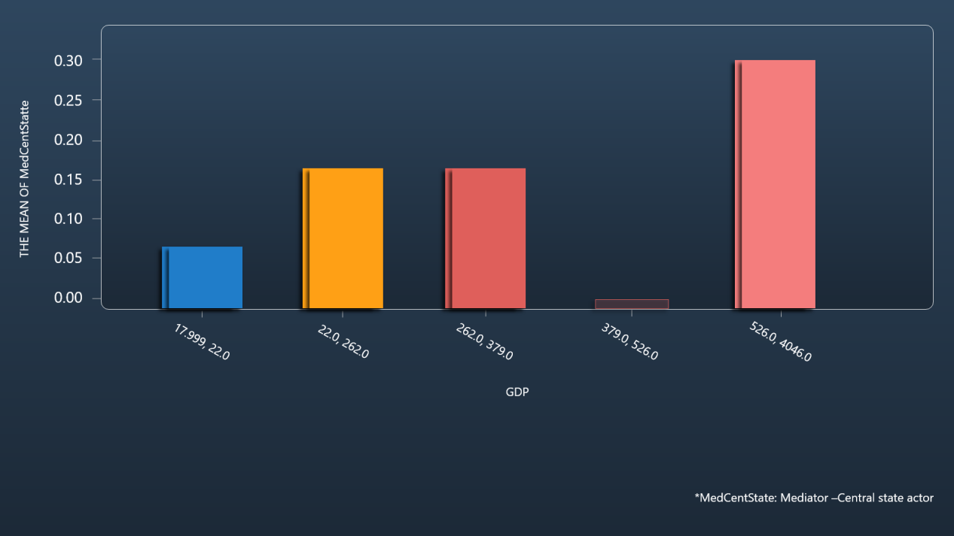
Anaysis 2
What factors might affect the type of mediator?
In the last assignment, our team member have done some analysis of mediators. We find that different regions have different mediators, so we guess whether the choice of mediator will be influenced by culture, regional economy and state of national government. The second analysis is about the reasons why different mediators are chosen in different regions.
We mainly analyzed the influence of culture and economy on the types of mediators.
In terms of culture, because one of the process types is Informal but persistent practice (PT_IPP), it represents a clear culture or practice of local peace agreement-making, so we use PT_IPP to verify the influence of culture on the mediator type.
In terms of economy, we use GDP as a symbol of economic strength. We mainly inquired about countries that signed peace agreements between 2016 and 2018 and used this to analyze the impact of the economy on the types of mediators.

Slide 10
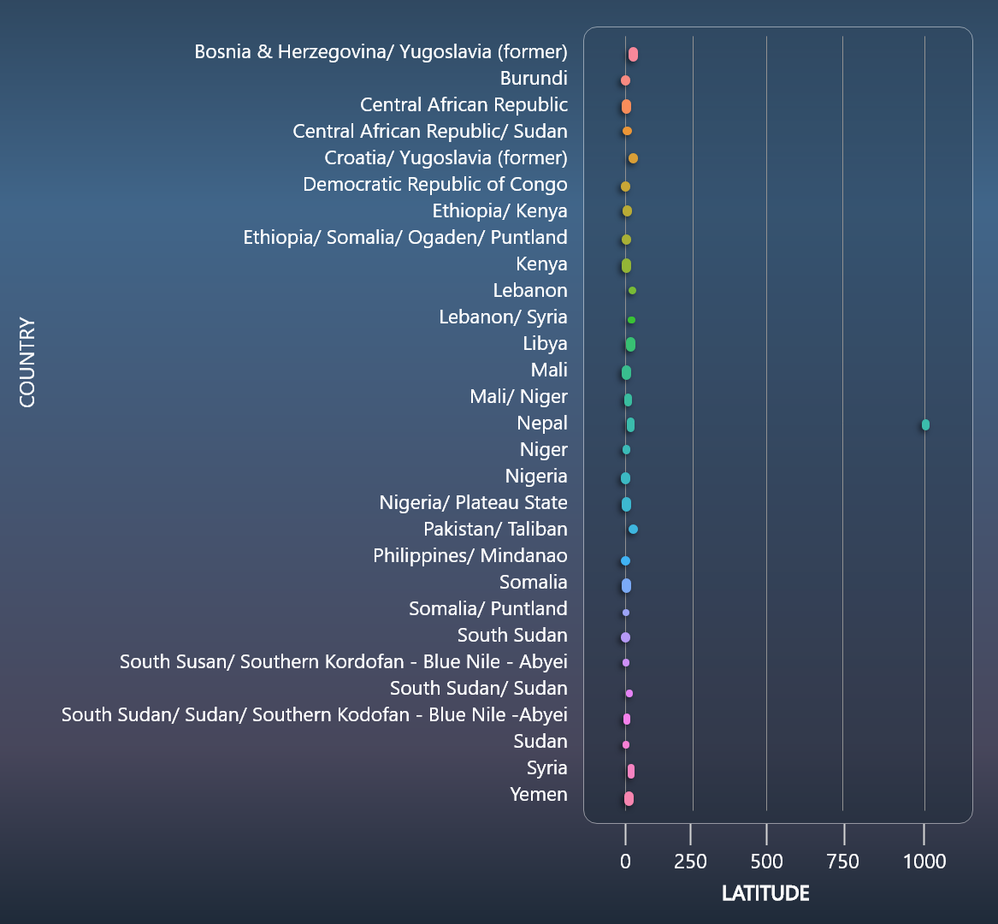


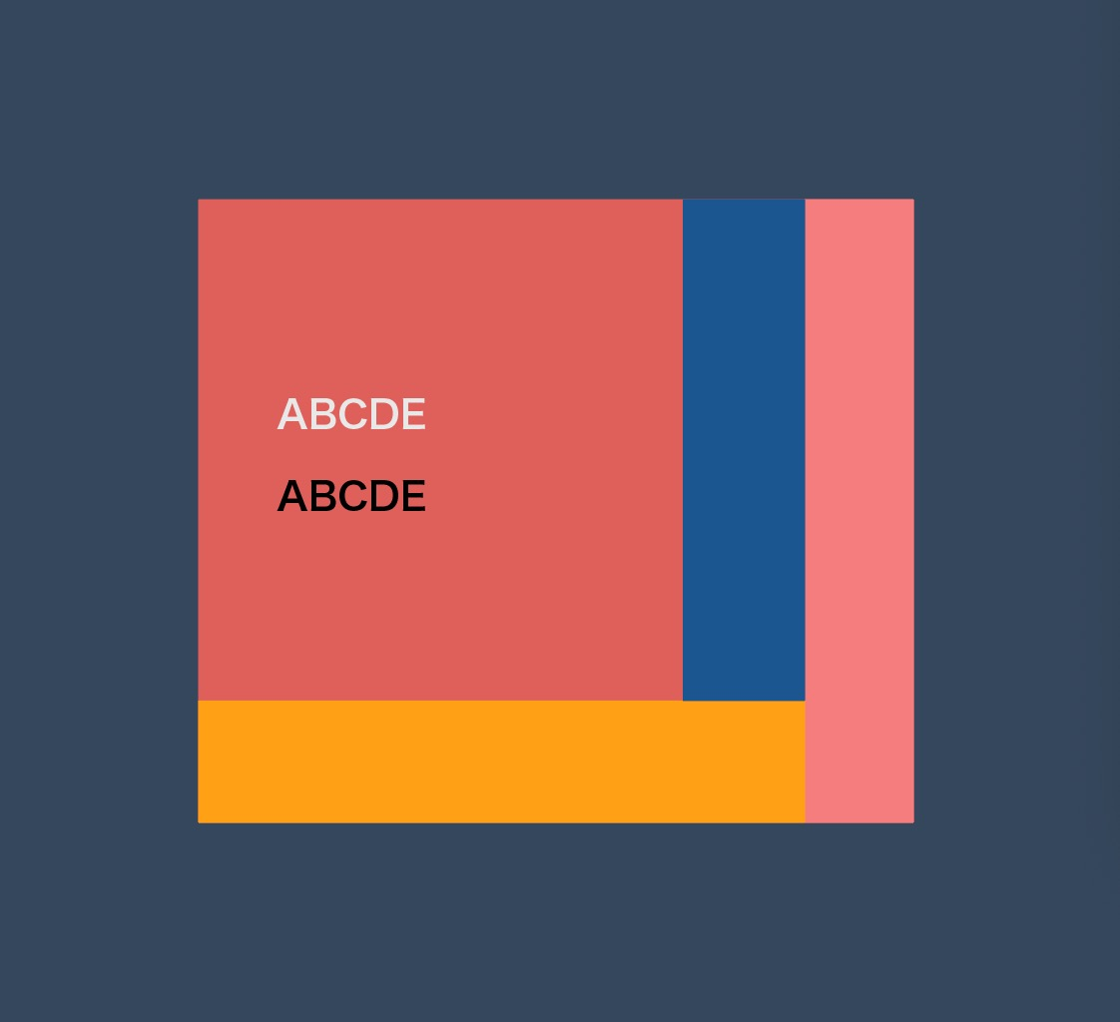
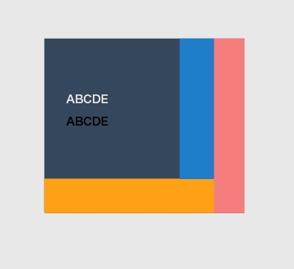
Visualization
Design concept
Website
Map
Color
Accessible for everyone
Interactions are easy to learn
Make it obvious for audience
Select from several color palettes

Slide 11

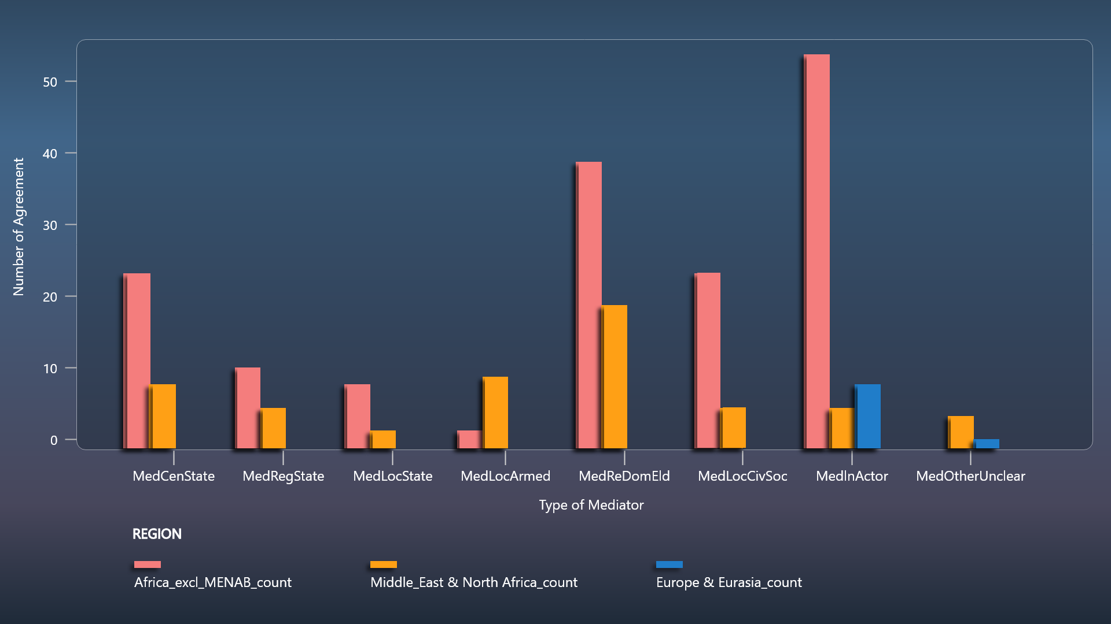
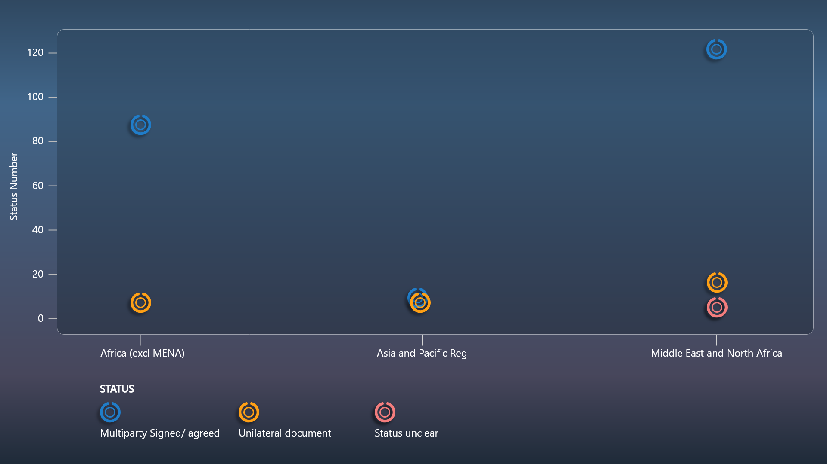
Visualization

Slide 12
Website

